Slide 1
Cloud assisted android application for ASU students
Application for Buses and Books
MIDTERM SUBMISSION
ADROIT
Chaitanya Yaddanapudi
Sarvani Mallajosyula

Slide 2
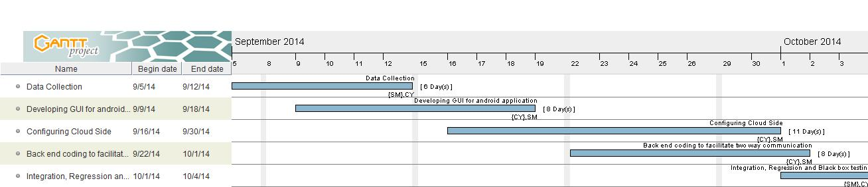
Tasks to be accomplished
Sno. | Task | Status | Date of Completion
1 | Data Collection | Completed | 09-13-2014
2 | Developing GUI | Completed | 09-19-2014
3 | Cloud Side | On Track | 09-30-2014

Slide 3
Tasks to be accomplished
Task 1 – Data Collection - By midterm submission
First task is to collect data related to bus timings and the bus routes. We will obtain this information from Orbit and Valley Metro bus service.

Slide 4
Task 1: Data Collection – Completed
As stated in the Project proposal, required bus routes and timings have been obtained from Orbit and Valley Metro bus services.
All the possible routes and timings have been collected to ensure up to date information.
Online References - http://routes.valleymetro.org/timetables/6/route_list

Slide 5
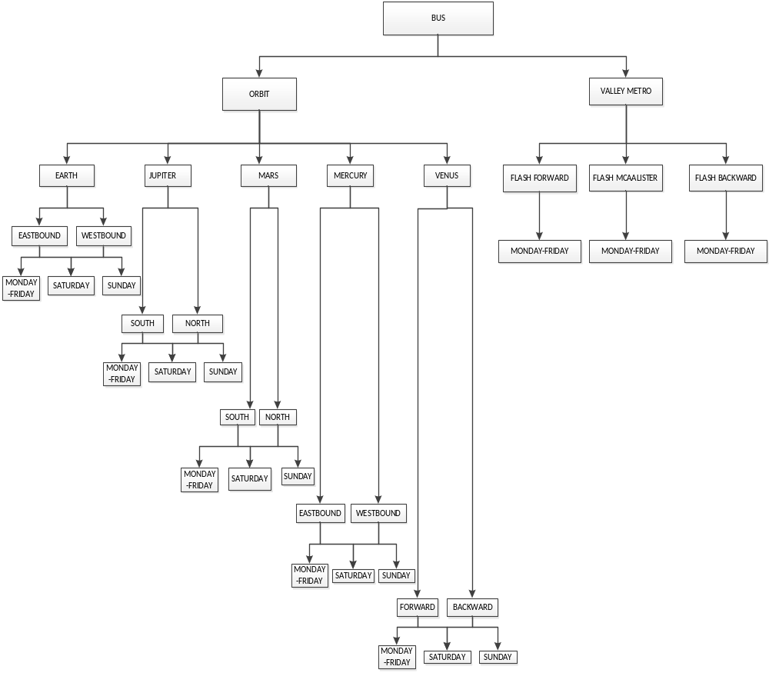
Task 1: Data Collection – Completed
Data has been collected for below mentioned buses

Slide 6
Tasks to be accomplished
Task 2: Developing GUI for the android application - By midterm submission
GUI has two options.
Buses
Books
Based on the user selection, appropriate screen will be displayed.
Task 4: Back end coding to facilitate two way communication
Task 5: Integration, Regression and Black box testing

Slide 7

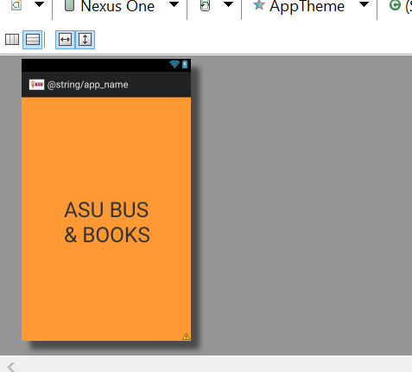
Task 2 GUI – Completed
Screen 1 – Boot up screen (1 or 2 sec)
Prototype Android Screen

Slide 8

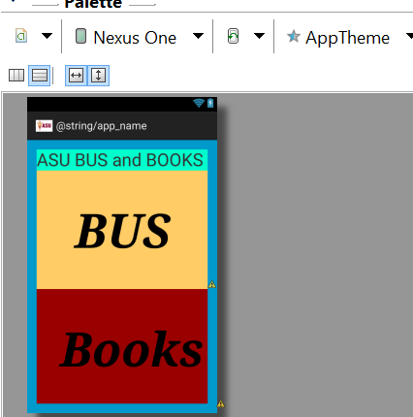
Task 2 GUI – Completed
Screen 2 – Select Buses or Books (buttons)
Prototype Android Screen

Slide 9
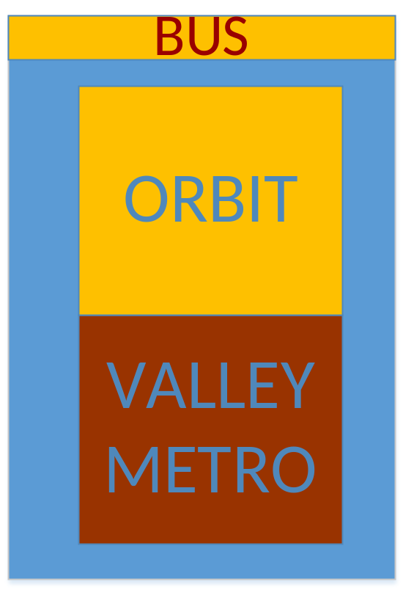
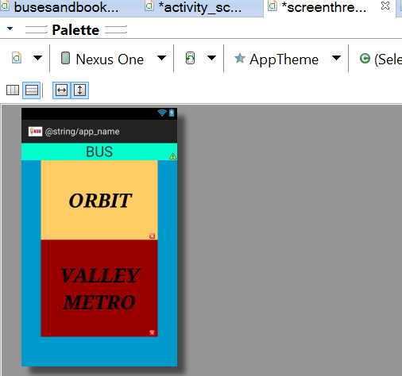
Task 2 GUI – Completed
Screen 3 – Select Orbit or Valley Metro (buttons)
Prototype Android Screen

Slide 10
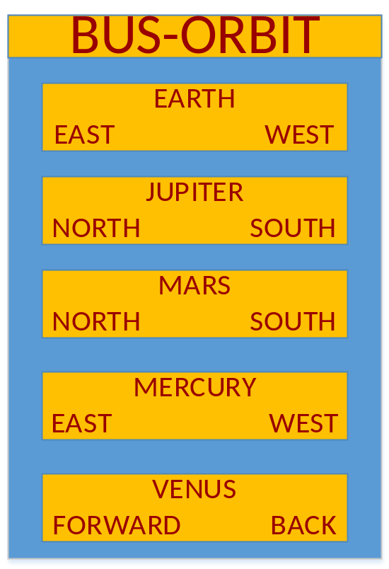
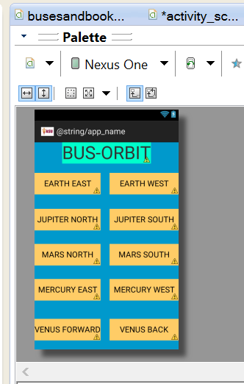
Task 2 GUI – Completed
Screen 4 – Choose the bus (buttons)
Prototype Android Screen

Slide 11
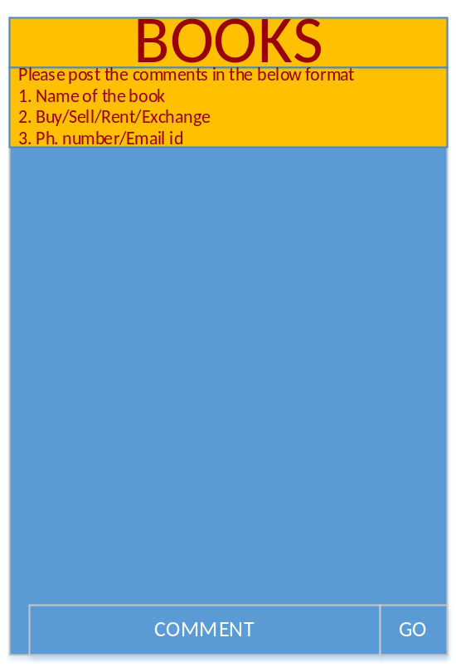
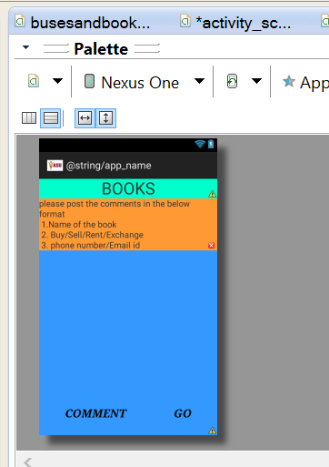
Task 2 GUI – Completed
Screen 5 – Read/Post comments (Books section)
Prototype Android Screen

Slide 12
Tasks to be accomplished
Task 3: Cloud side - By 30th September
Creation of tables in MySQL database in the Virtual Machine (Ubuntu) on Cloud – Vlab.

Slide 13
Task 3 Cloud Side – On Track
Data base – BUS has been created in VM
Tables by names have been created
EARTHEAST
EARTHWEST
JUPITERSOUTH
JUPITERNORTH
MARSSOUTH
MARSNORTH
MERCURYEAST
MERCURYWEST
VENUSFORWARD
VENUSBACK

Slide 14
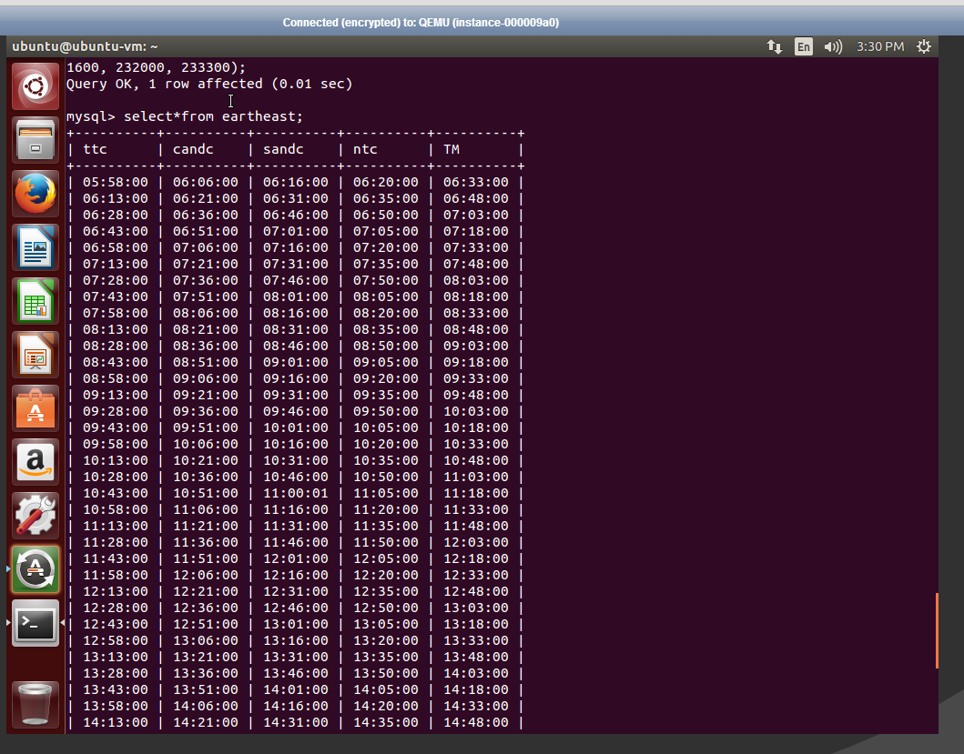
Task 3 Cloud Side – On Track
Examples of tables created in MySQL:
EarthEast:

Slide 15
Future tasks as per proposal
Sno. | Task | Status | Date of Completion
3 | Cloud Side | On Track | 09-30-2014
4 | Back end coding to facilitate two way communication | To be started | 10-02-2014
5 | Testing | To be started | 10-04-2014

